Slide 1

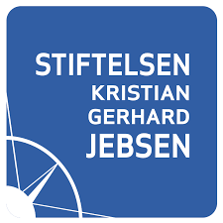




PRECISION MEDICINE IN DIABETES: LEARNING FROM MONOGENIC DIABETES
Thoresen Seminar, DNV, Oslo, 251119
Prof. Pål R. Njølstad, MD PhD
Center for Diabetes Research, UiB/Haukeland, Bergen, Norway
Broad Institute of Harvard & MIT, Cambridge, USA

Slide 2
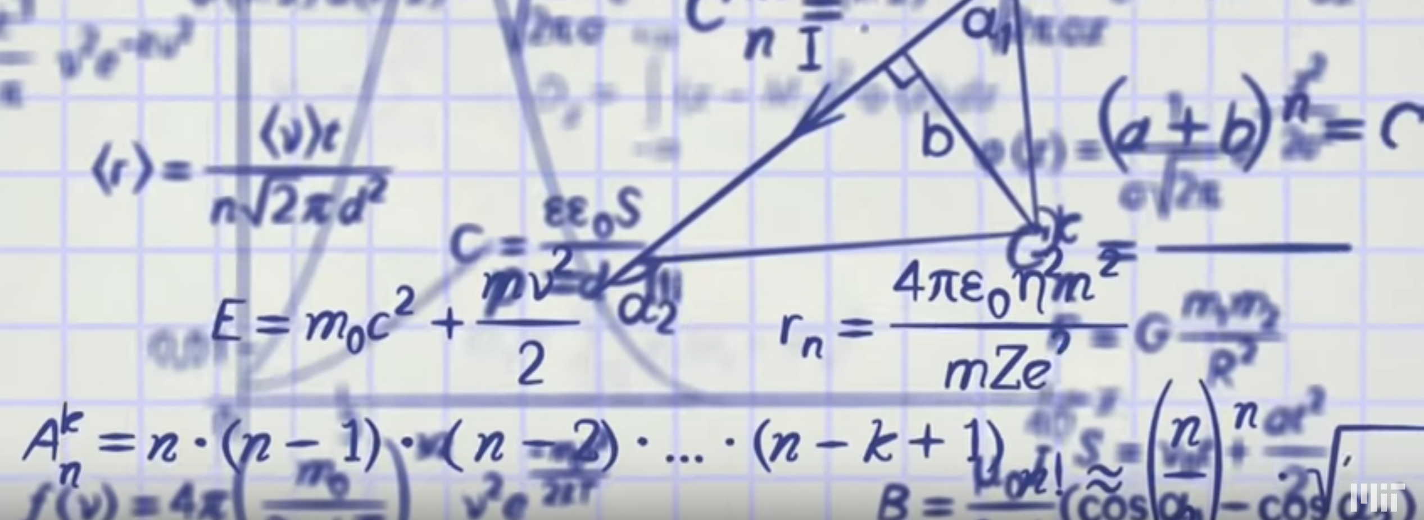


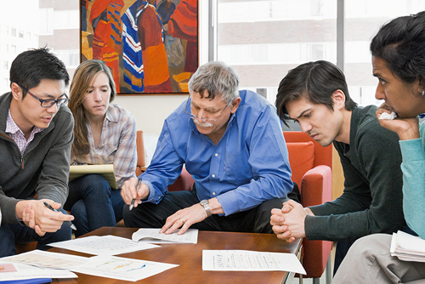
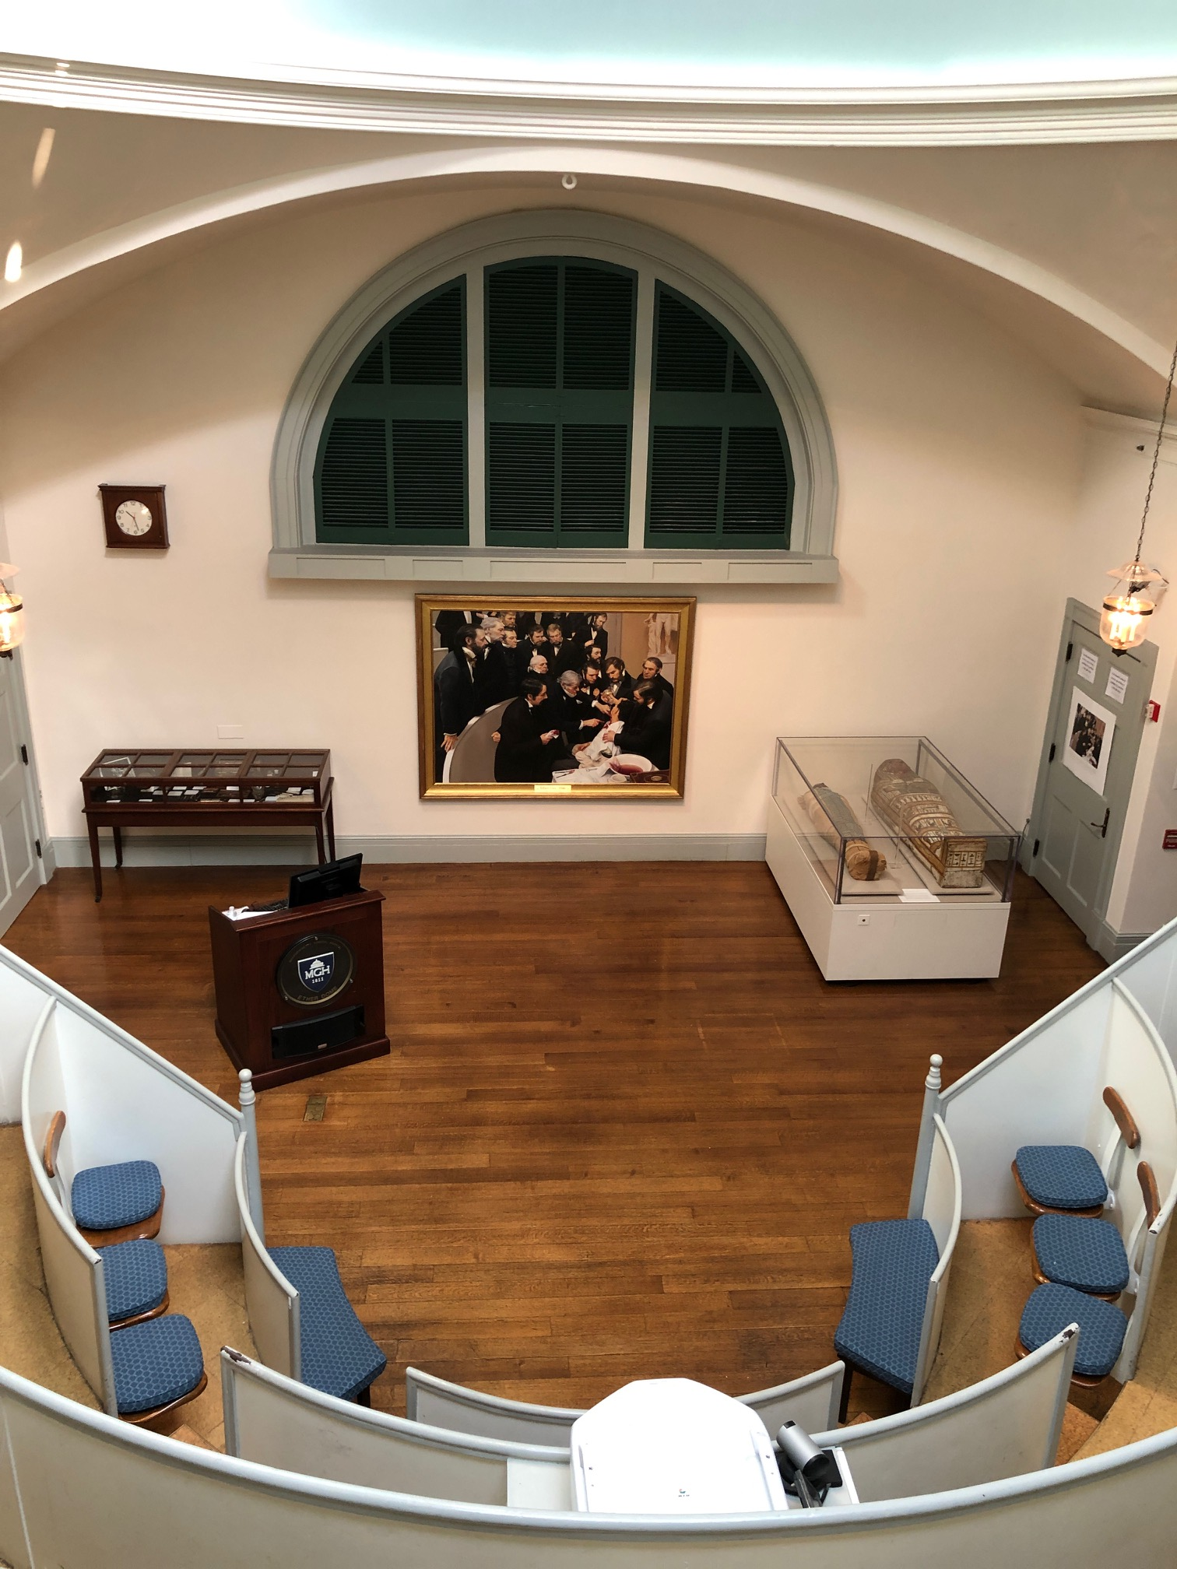



Greetings from Boston & Cambridge!
Sabbatical stay 2018-19
I have something to declare:
I am a NEVER TRUMPER
Notes:
Tilbake I går. 4. opphold USA. Broad vel 10 år, Eric Lander CEO. Matematiker, forsker og direktør. Flink med fund raising – ca 2 milliard $. Broad og Stanley. Fortsatt undervisning og forskning. Uvanlig spirit. Forslag Nobel-pris for sekv av humane genom.
Også MGH en dag per uke. Et av verdsns beste sykehus. Her fra The Ether Dome – første narkose – I eterrus
Harvard Med School, USAs mest prestisjefylte undervisning og forskning innen medisin

Slide 3
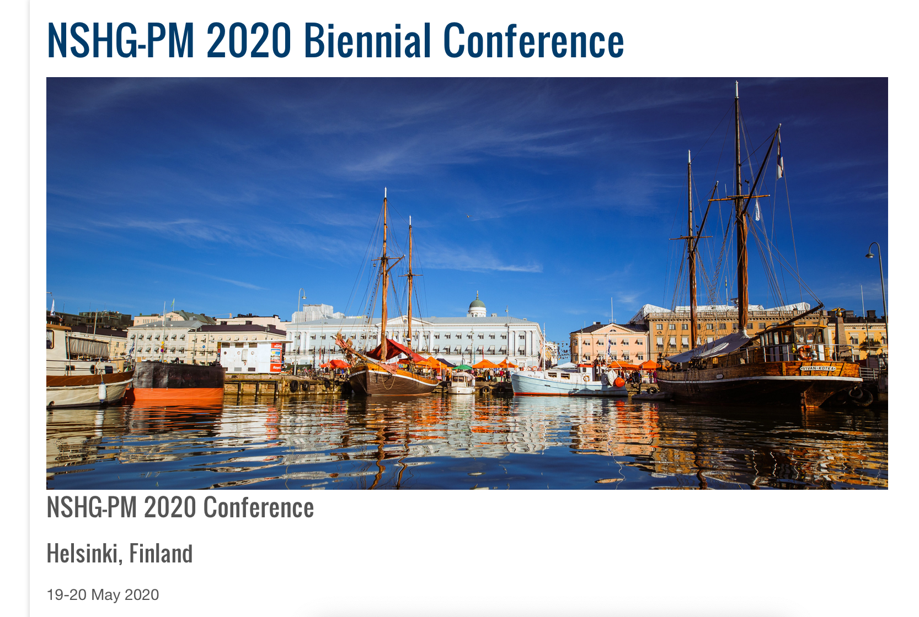
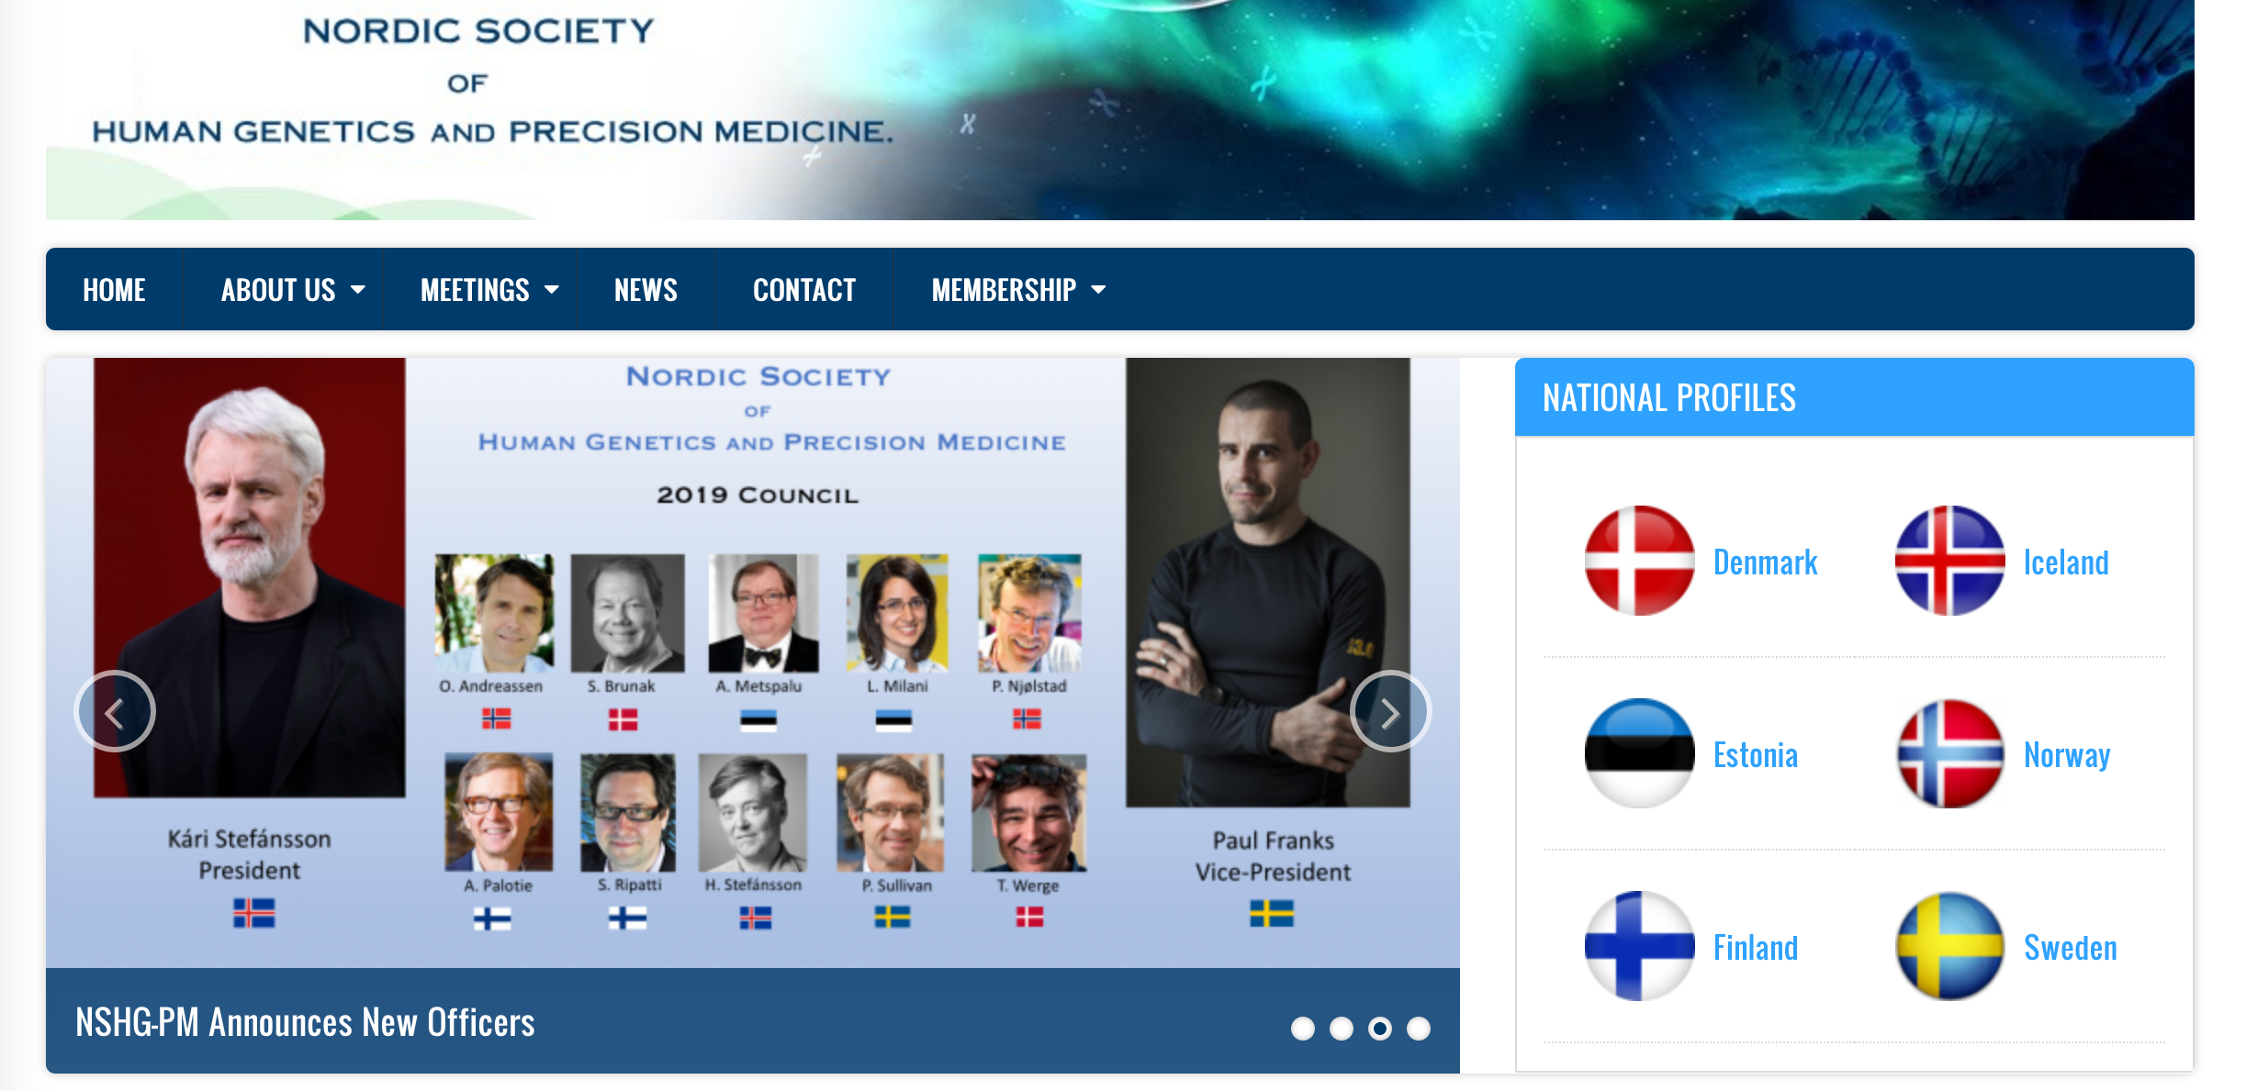

Slide 4
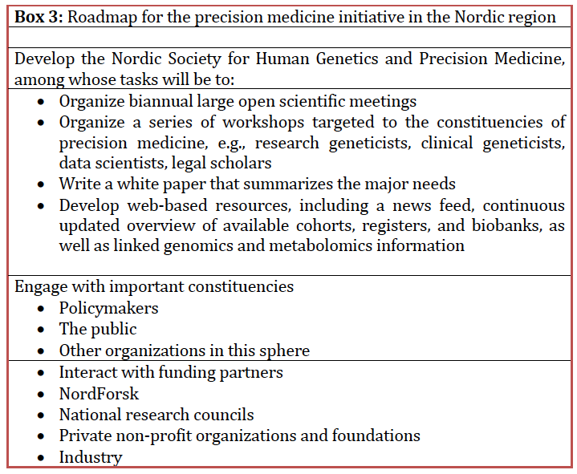
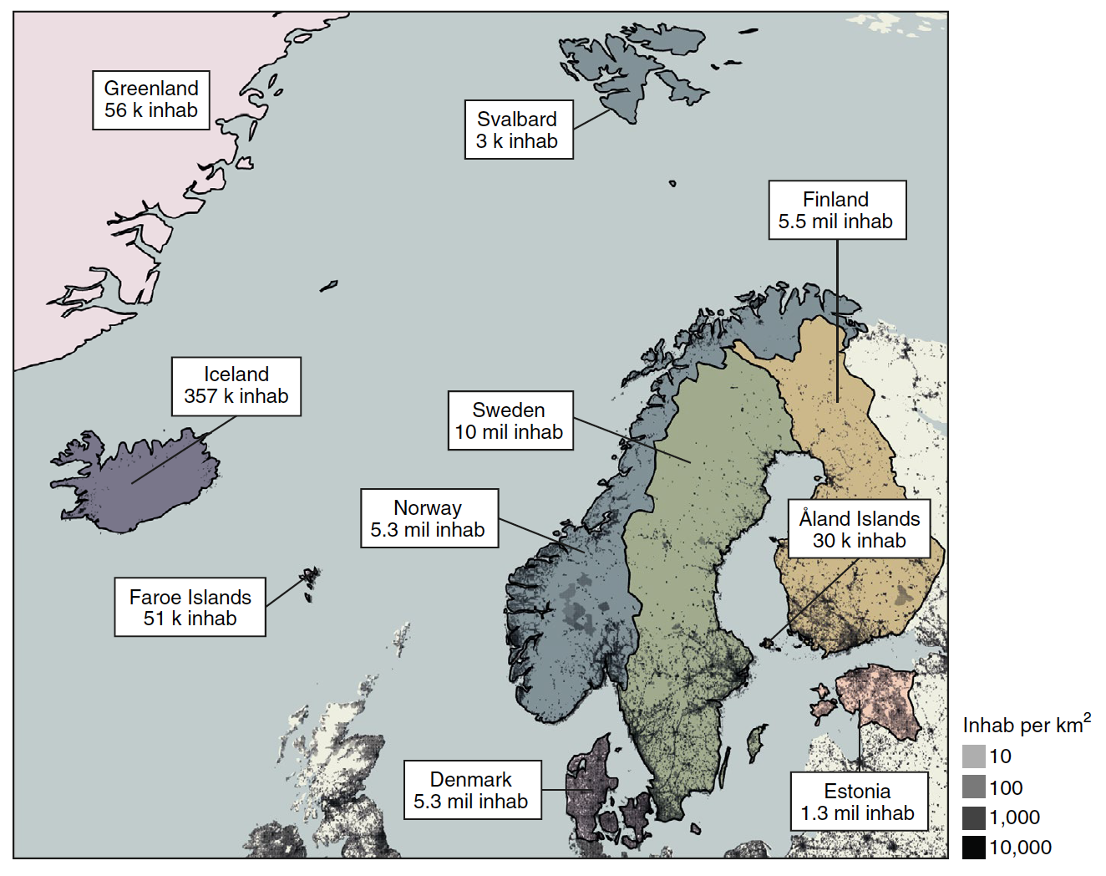
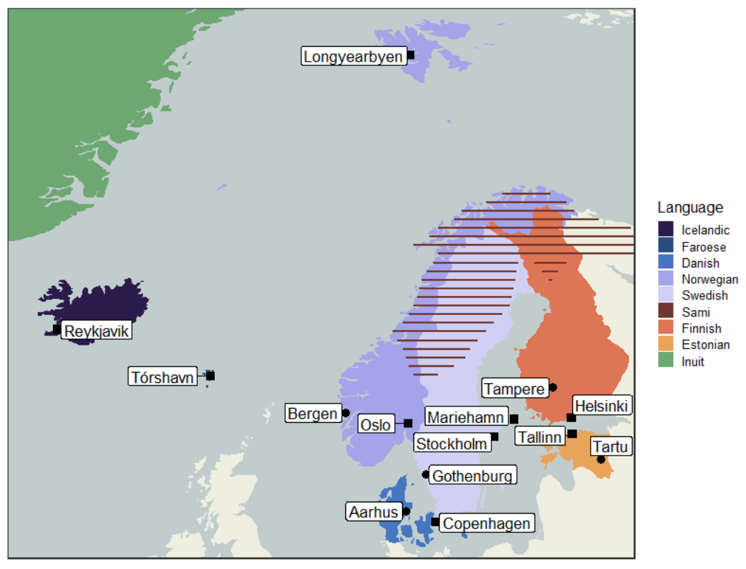
Statement paper in Nat Genet
Njølstad, Andreassen, Hovig, Hveem, Stoltenberg et al., Nature Genet, 2018

Slide 5
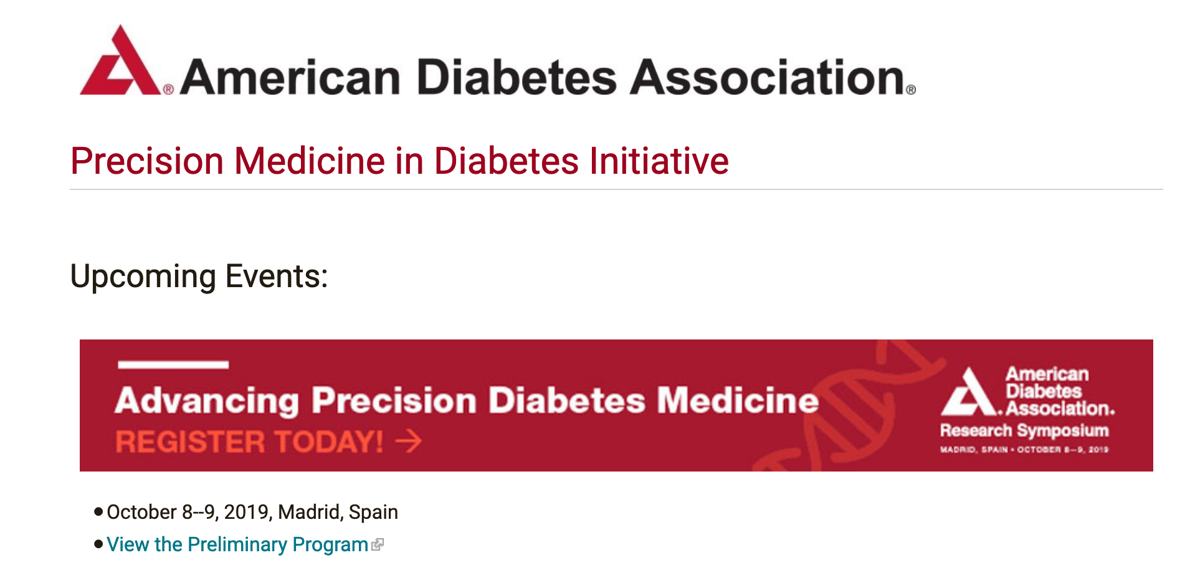
ADA Precision Diabetes Medicine Taskforce
Statement paper 2020 (task force group)
Comprehensive evidence-based paper 2022 (task force group and additional experts)

Slide 6
Diabetes is associated with over 500 loci
Type 1 and type 2
diabetes
Common gene variants
Increased risk
Monogenic diabetes
Rare variants
Mutation one gene → diabetes
Flannick, Johansson & Njølstad, Nature Rev Endocrinol, 2016

Slide 7
Monogenic subtypes in Norway
INS (MODY10)
ABCC8 (MODY12)
KCNJ11 (MODY13)
CEL (MODY8)
HNF1B (MODY5)
HNF4A (MODY1)
8.5 %
5 %
49 %
HNF1A (MODY3)
GCK (MODY2)
33 %
Norwegian MODY Registrt, 2019

Slide 8
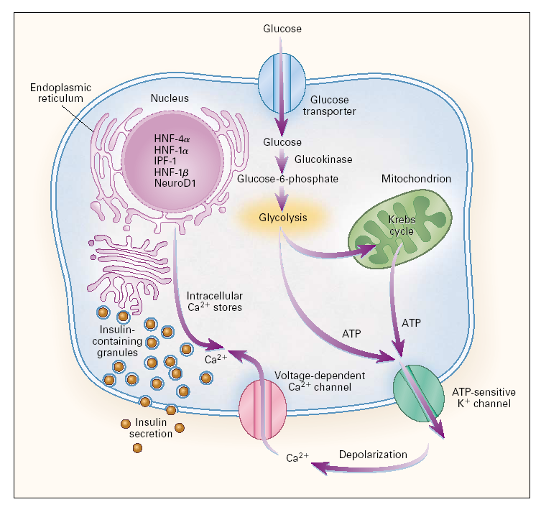
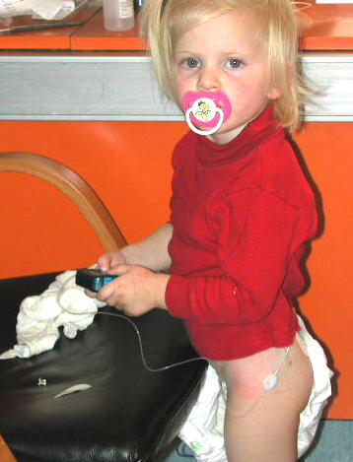
Therese neonatal diabetes due to KCNJ11
Insulin stops
K_{ATP} channel
KCNJ11
Sulfonyl-urea
Gloyn, Molnes, Njølstad et al, NEJM, 2004; Sagen et al, Diabetes, 2004

Slide 9
Therese can use tablets instead of insulin
Insulin
Sulfonylurea
Blood glucose
Sagen et al, Diabetes 2004

Slide 10
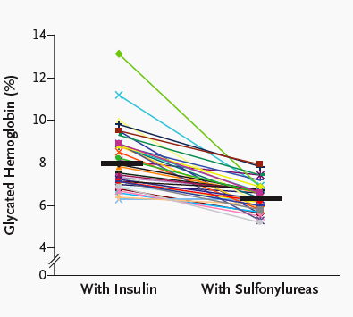
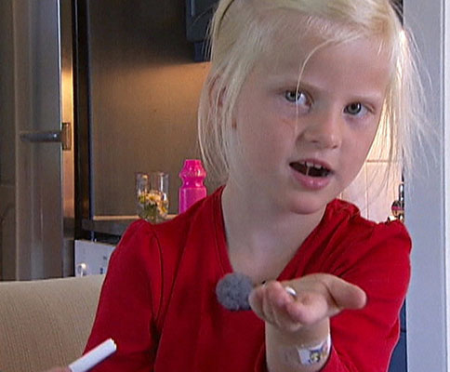
Many others, too – and HbA_{1c} improves
TV2, 2006
Pearson/Flechtner/Njølstad et al, NEJM, 2006

Slide 11
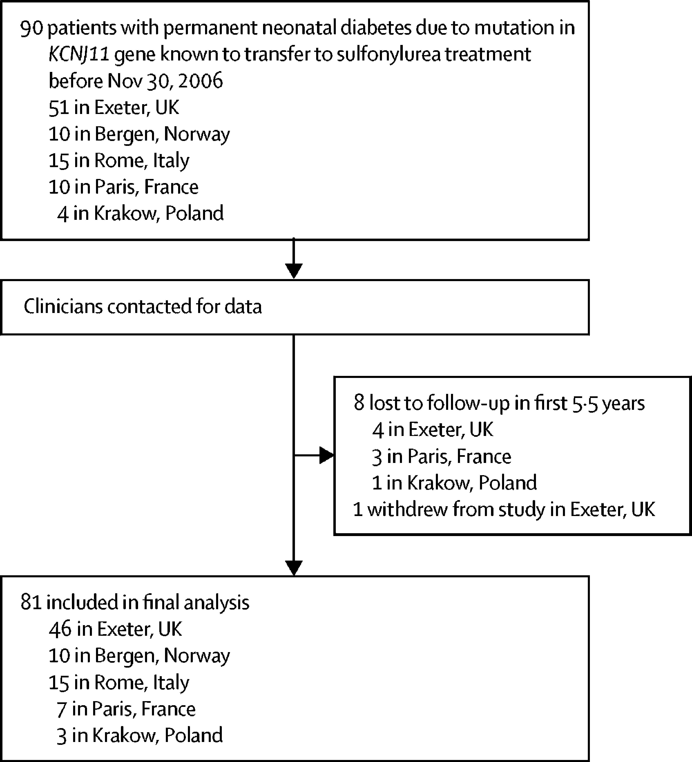
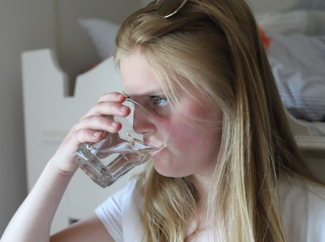
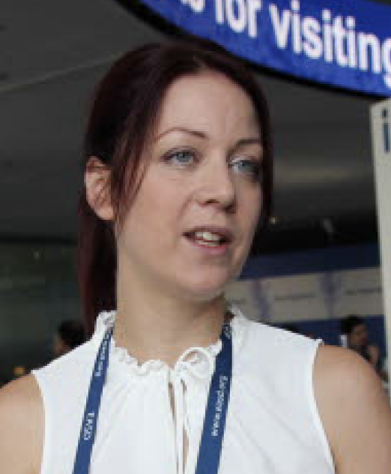
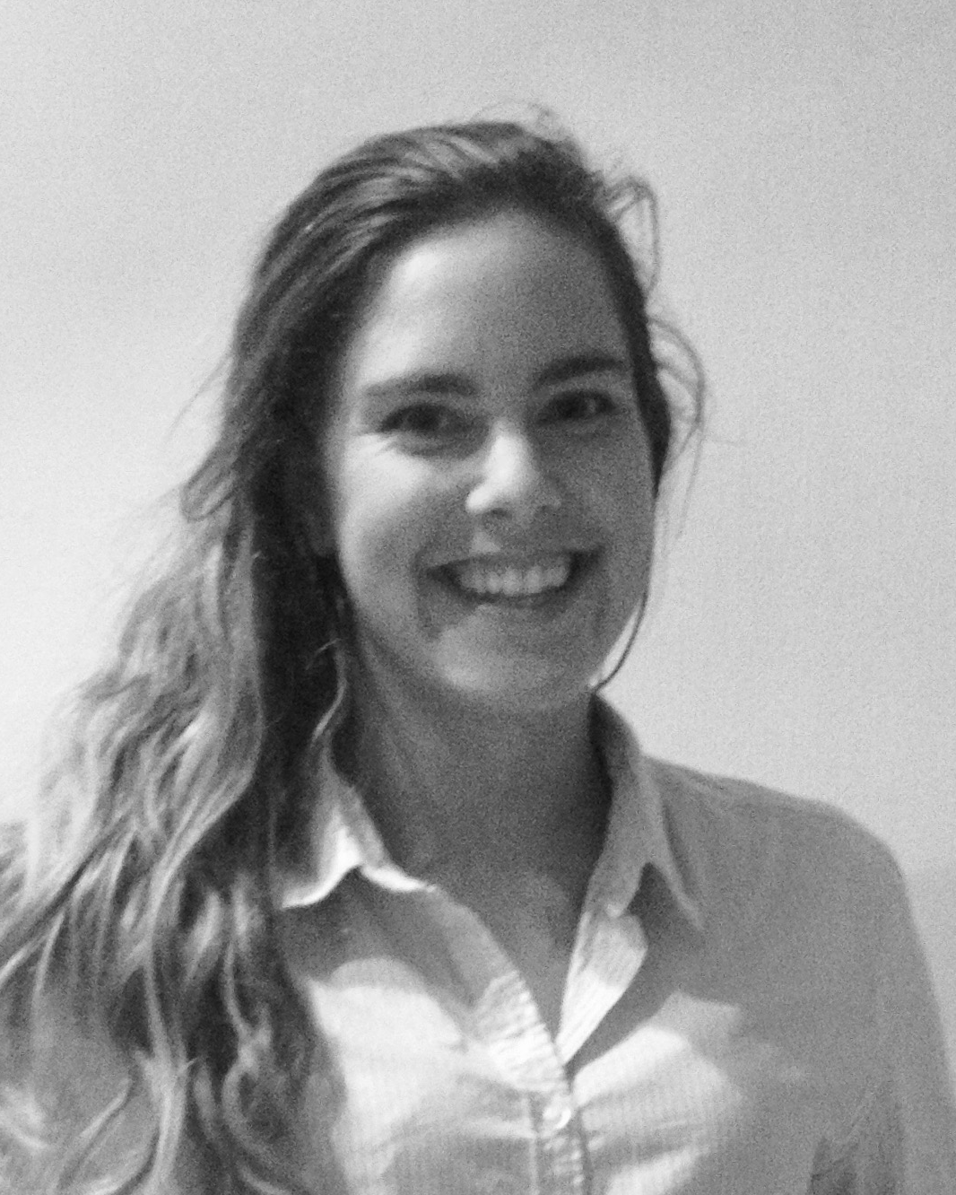
Therese 16 y off – what is long-term prognosis?
Pernille Svalastoga, Åsta Sulen - Bergen
Pamela Bowmann, Andrew Hattersley - Exeter
Michel Polak, Jacques Beltrand - Paris
Fabrizio Barbetti, Dario Iafusco - Rome
Magdalena Szopa, Iwas Klimes - Prague
Bowmann, Sulen,…Hattersley & Njølstad, Lancet D&E, 2018

Slide 12
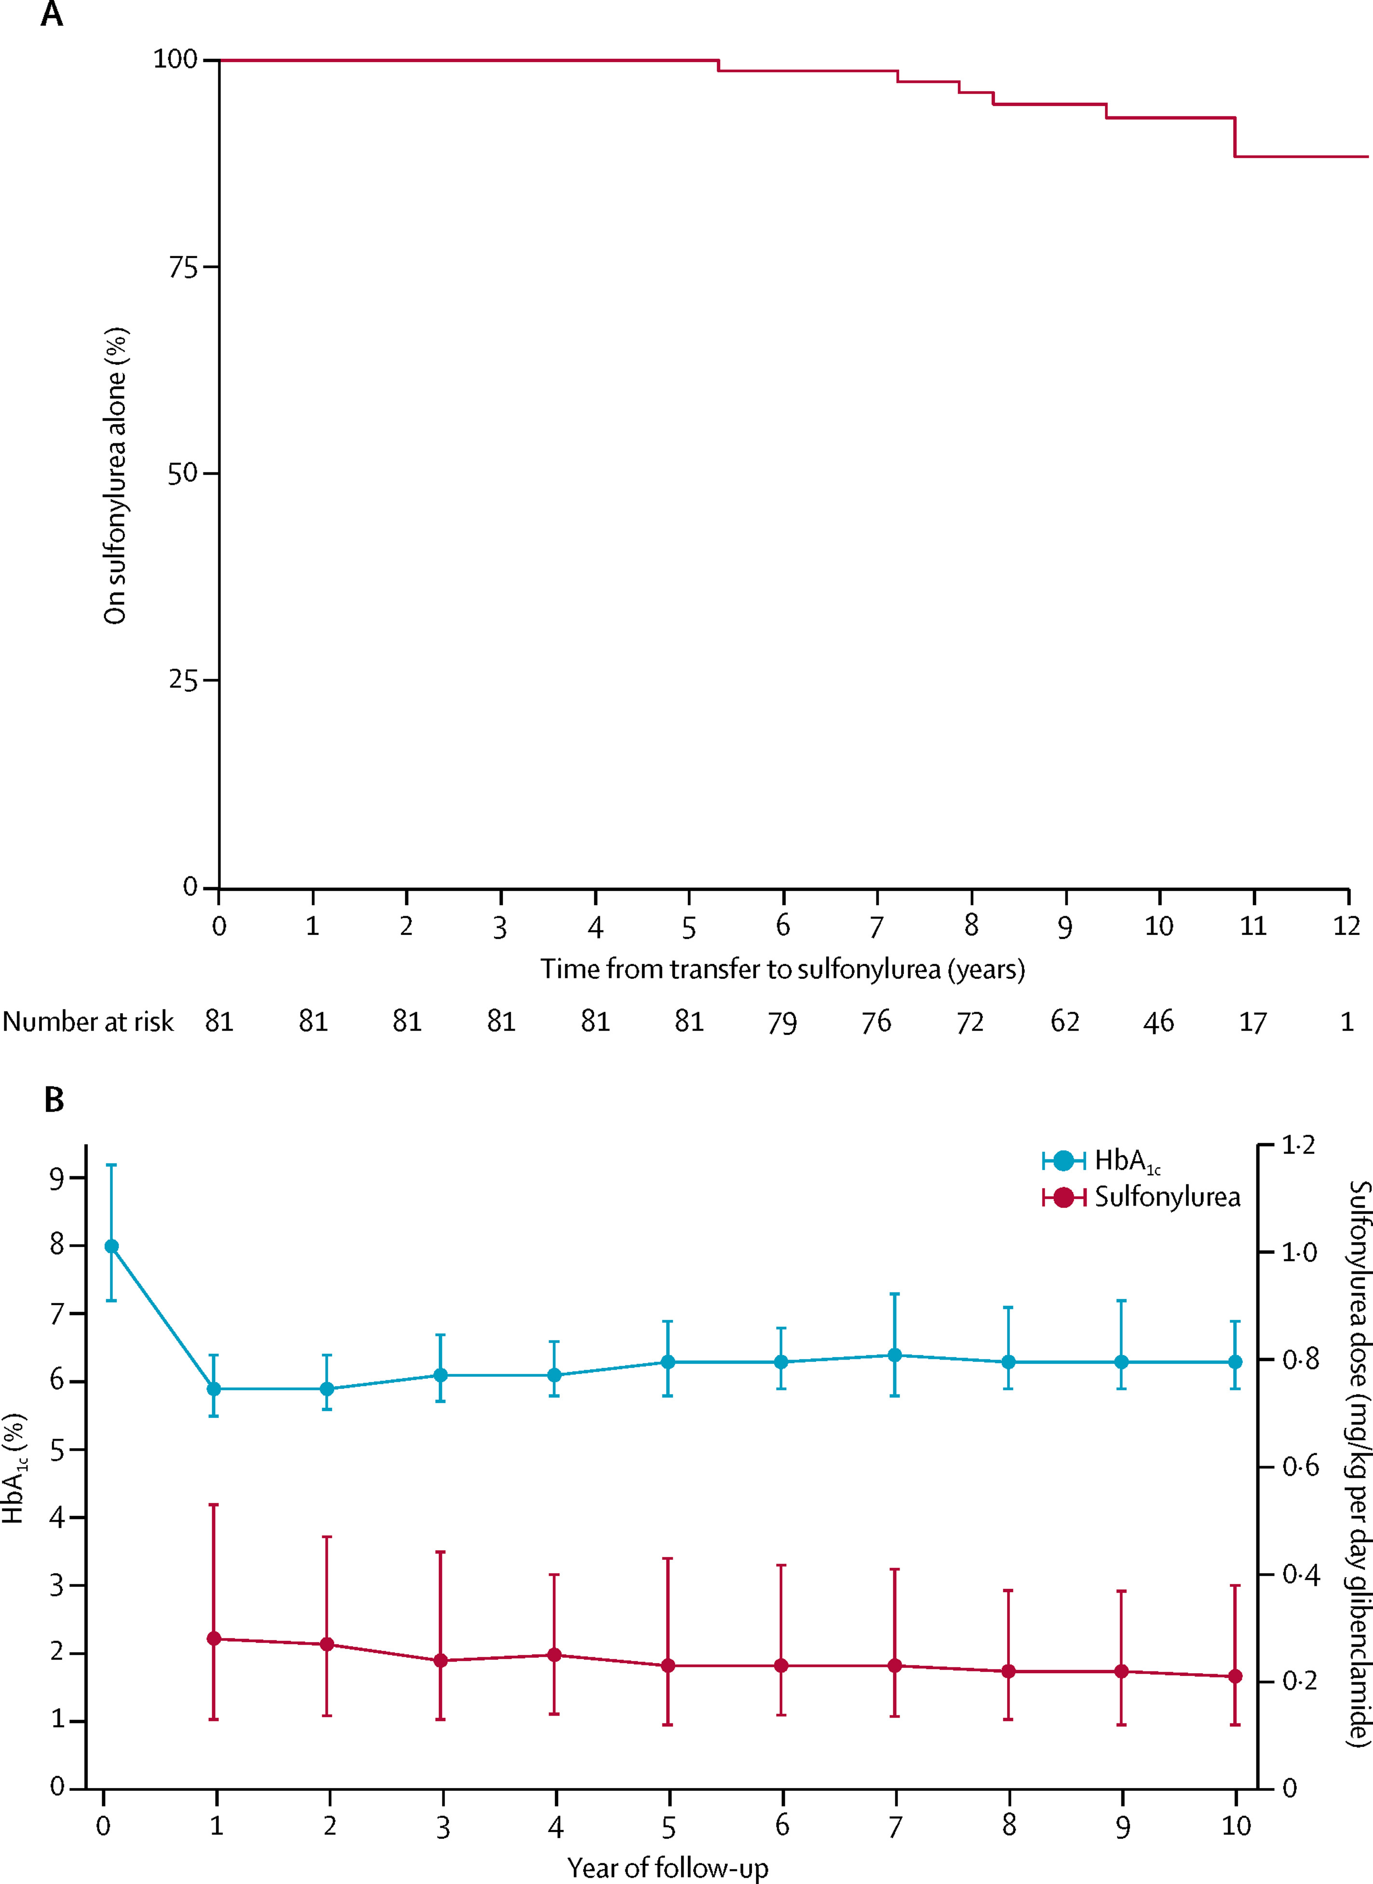
Sulfonylurea is effective for 10 years
93% remained on sulfonylureas without insulin
None discontinued sulfonylurea
Bowmann, Sulen,…Hattersley & Njølstad, Lancet D&E, 2018

Slide 13
Metabolic control is maintained over 10 years
Excellent glycemic control maintained
Sulfonylurea dose fell
No side effects
Bowmann, Sulen,…Hattersley & Njølstad, Lancet D&E, 2018

Slide 14
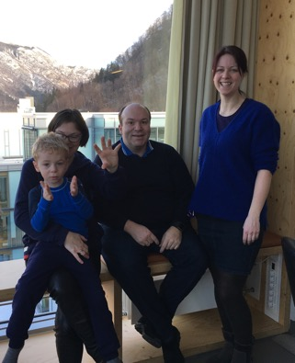
Neonatal diabetes – more than diabetes
Maximilian - 4.8 yrs old
  Dx KCNJ11 V59M 2 months
  Sulfonylurea from 4 months
  HbA1c 40 mmol/mol (5.8%)
Neurological problems
  Hypotonia
  Motor developmental delay
  Intellectual disability
  ADHD
Svalastoga et al, in review

Slide 15
Norwegian cohort KCNJ11 neonatal diabetes
Spectrum of neuropsychiatry
Moderate intellectual disability
Global developmental delay
No effect on CNS by sulfonylurea
-----------------------------------------
IQ in subnormal range
ADHD
Non-verbal learning disability
V59M
Non-V59M
→ Need early detection, interdisciplinary approach, family support
Svalastoga et al, in review

Slide 16
Precision medicine
  Neonatal diabetes is a brilliant example
    When a mutation in KCNJ11:
    Sulfonylurea tablets instead of insulin injections
    Improves QOL and metabolic control
    V59M: CNS features that need attention
  Other monogenic subtypes
    Relevance for dx, treatment, prognosis

Slide 17
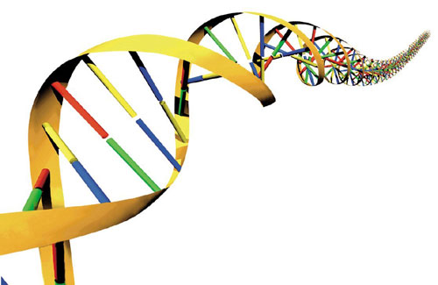
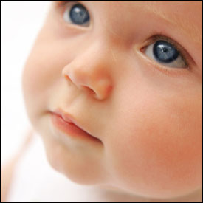
Novel Tools for Early Childhood Predisposition to Obesity and Diabetes
SEVENTH FRAMEWORK PROGRAMME
"Ideas” - European Research Council - Advanced Grant
Project acronym: SELECTionPREDISPOSED
Grant agreement no.: 293574
Professor Pål Rasmus Njølstad, UiB

Slide 18
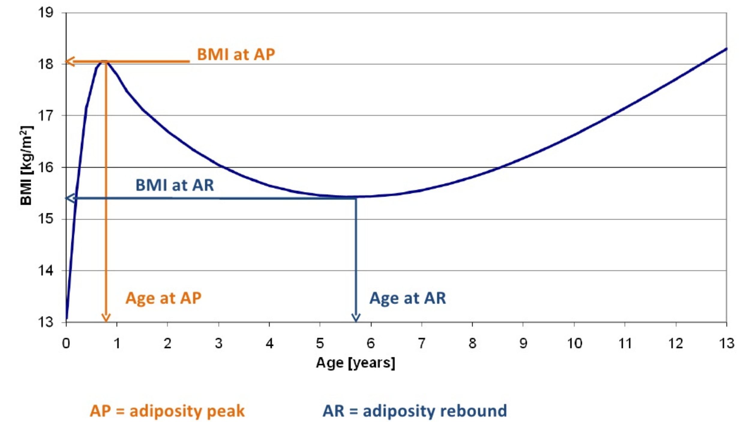
Background and questions
Obese children come to medical attention too late
Intervention needs to take place before school age
Are there transient genetic effects during early growth?
Are there parent of origin effects during early growth?
Can we develop tools to select predisposed for early intervention?
Typical change in infant/child BMI (kg/m²)

Slide 19
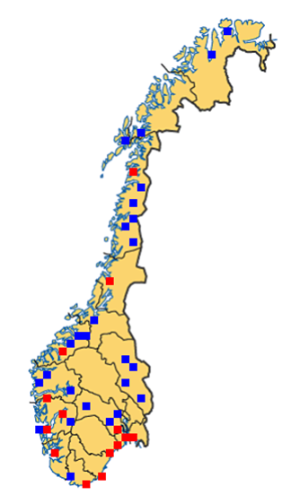

Tools: Norwegian Mother, Father and Child Cohort Study (MoBa)
One of the world´s largest and best population-based pregnancy cohorts
Enrolled 110,000 newborns, 90,000 mothers, 70,000 fathers
Follow mothers and fathers through pregnancy and after
Offspring 12 timepoints from birth to 8 years of age
Questionnaires with a wealth of data
Biological samples (blood, urine, teeth, stools) from all
Follow offspring from 8-18 years
Medical Birth Registry data included
Can be linked to Norwegian health and social science registries
Genetic analyses not initiated

Slide 20

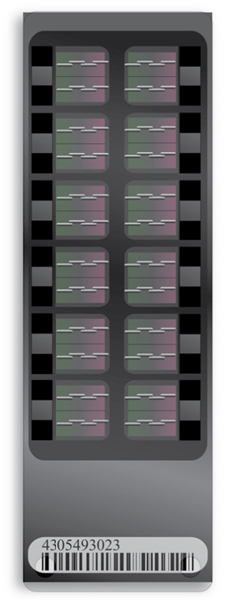
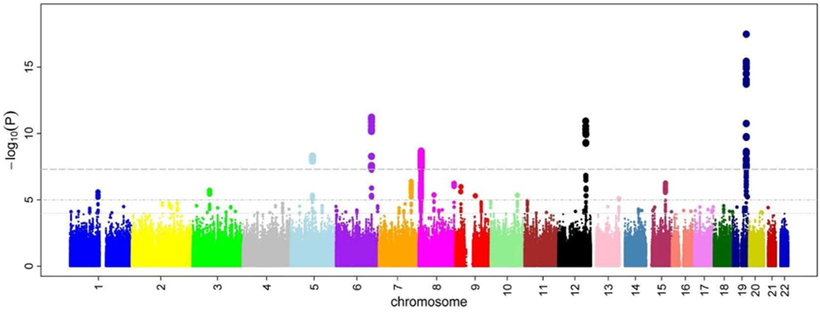
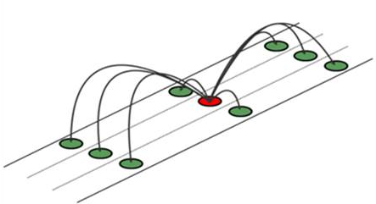
Tools: Genome-Wide Assocation Study
Cohort
Genotyping
Imputation
Analyses
Quality control
birth
12 months
2 years
… 8 years
51,000 random samples (in trios) from the Mother and Child Cohort Study
Illumina exome chips
Done in Norway and Rotterdam
Software analyses done in our group
Collaboration with NTNU and NIPH
Single point analyses for 12 measurement points from birth to 8 years
Notes:
- Cohort: 13 measurement points from age 0 to 8 years

Slide 21
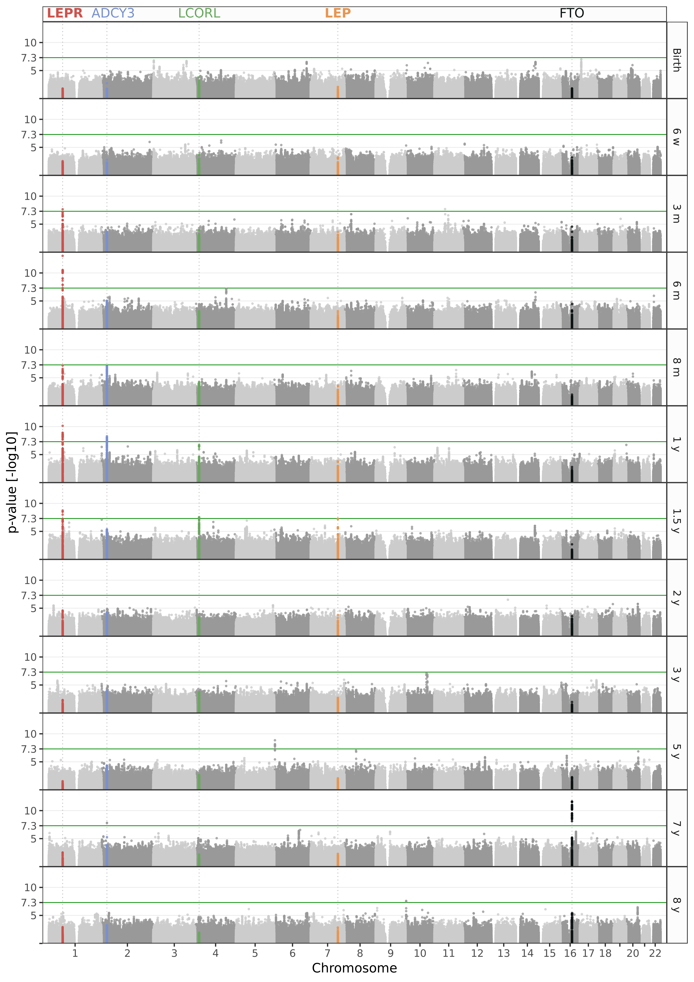
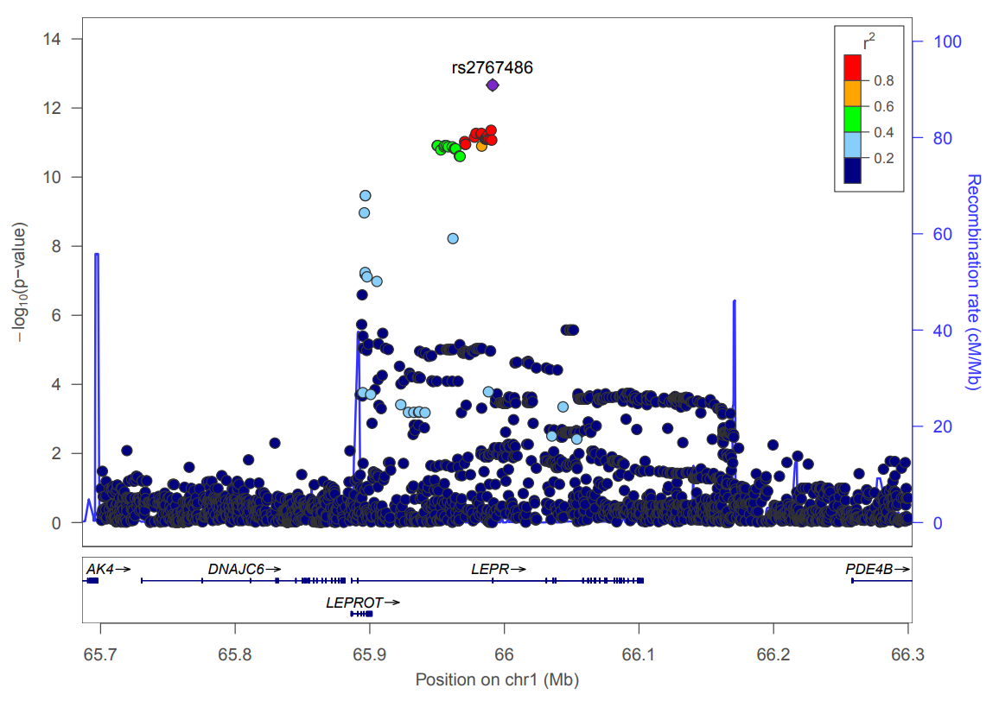
What did we find?
Manhattan plots
12 data points (0-8 years)
Highly significant signals associated with BMI for the genes:
LEPR, ADCY3, LCORL, LEP, FTO

Slide 22
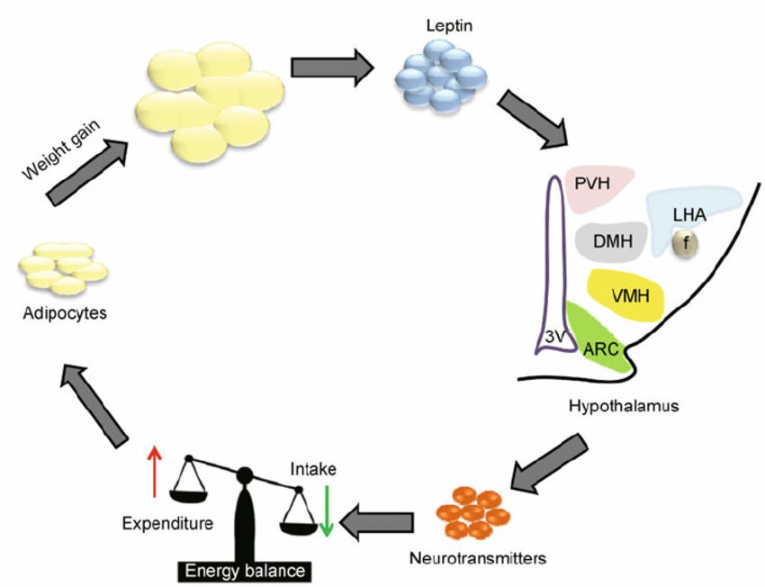
A novel signature for healthy infant growth
There ARE transient genetic effects during early growth
We now study parent of origin effects during early growth
We are trying to develop tools to select predisposed for early intervention
Transient effect in the leptin receptor (LEPR) and leptin (LEP) gene loci:
Play key roles of common variation in the leptin signaling pathway for healthy infant growth

Slide 23
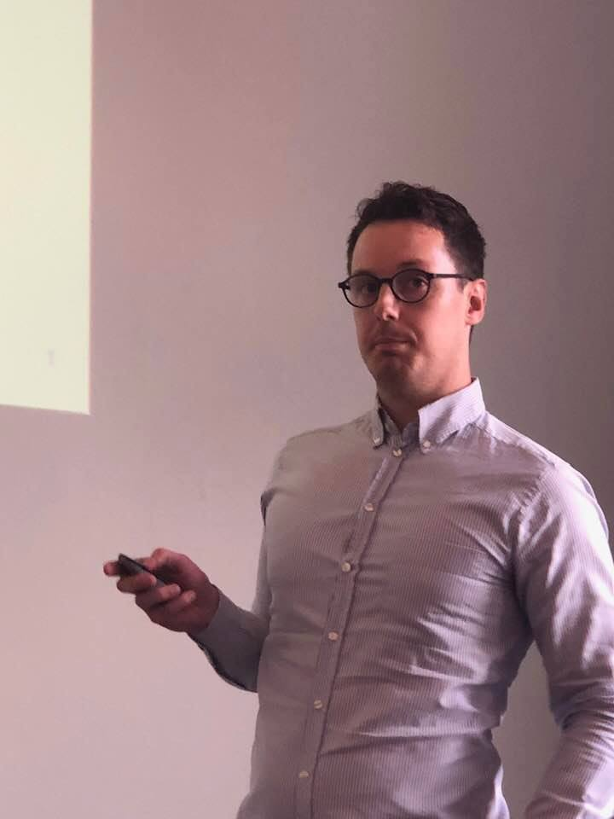
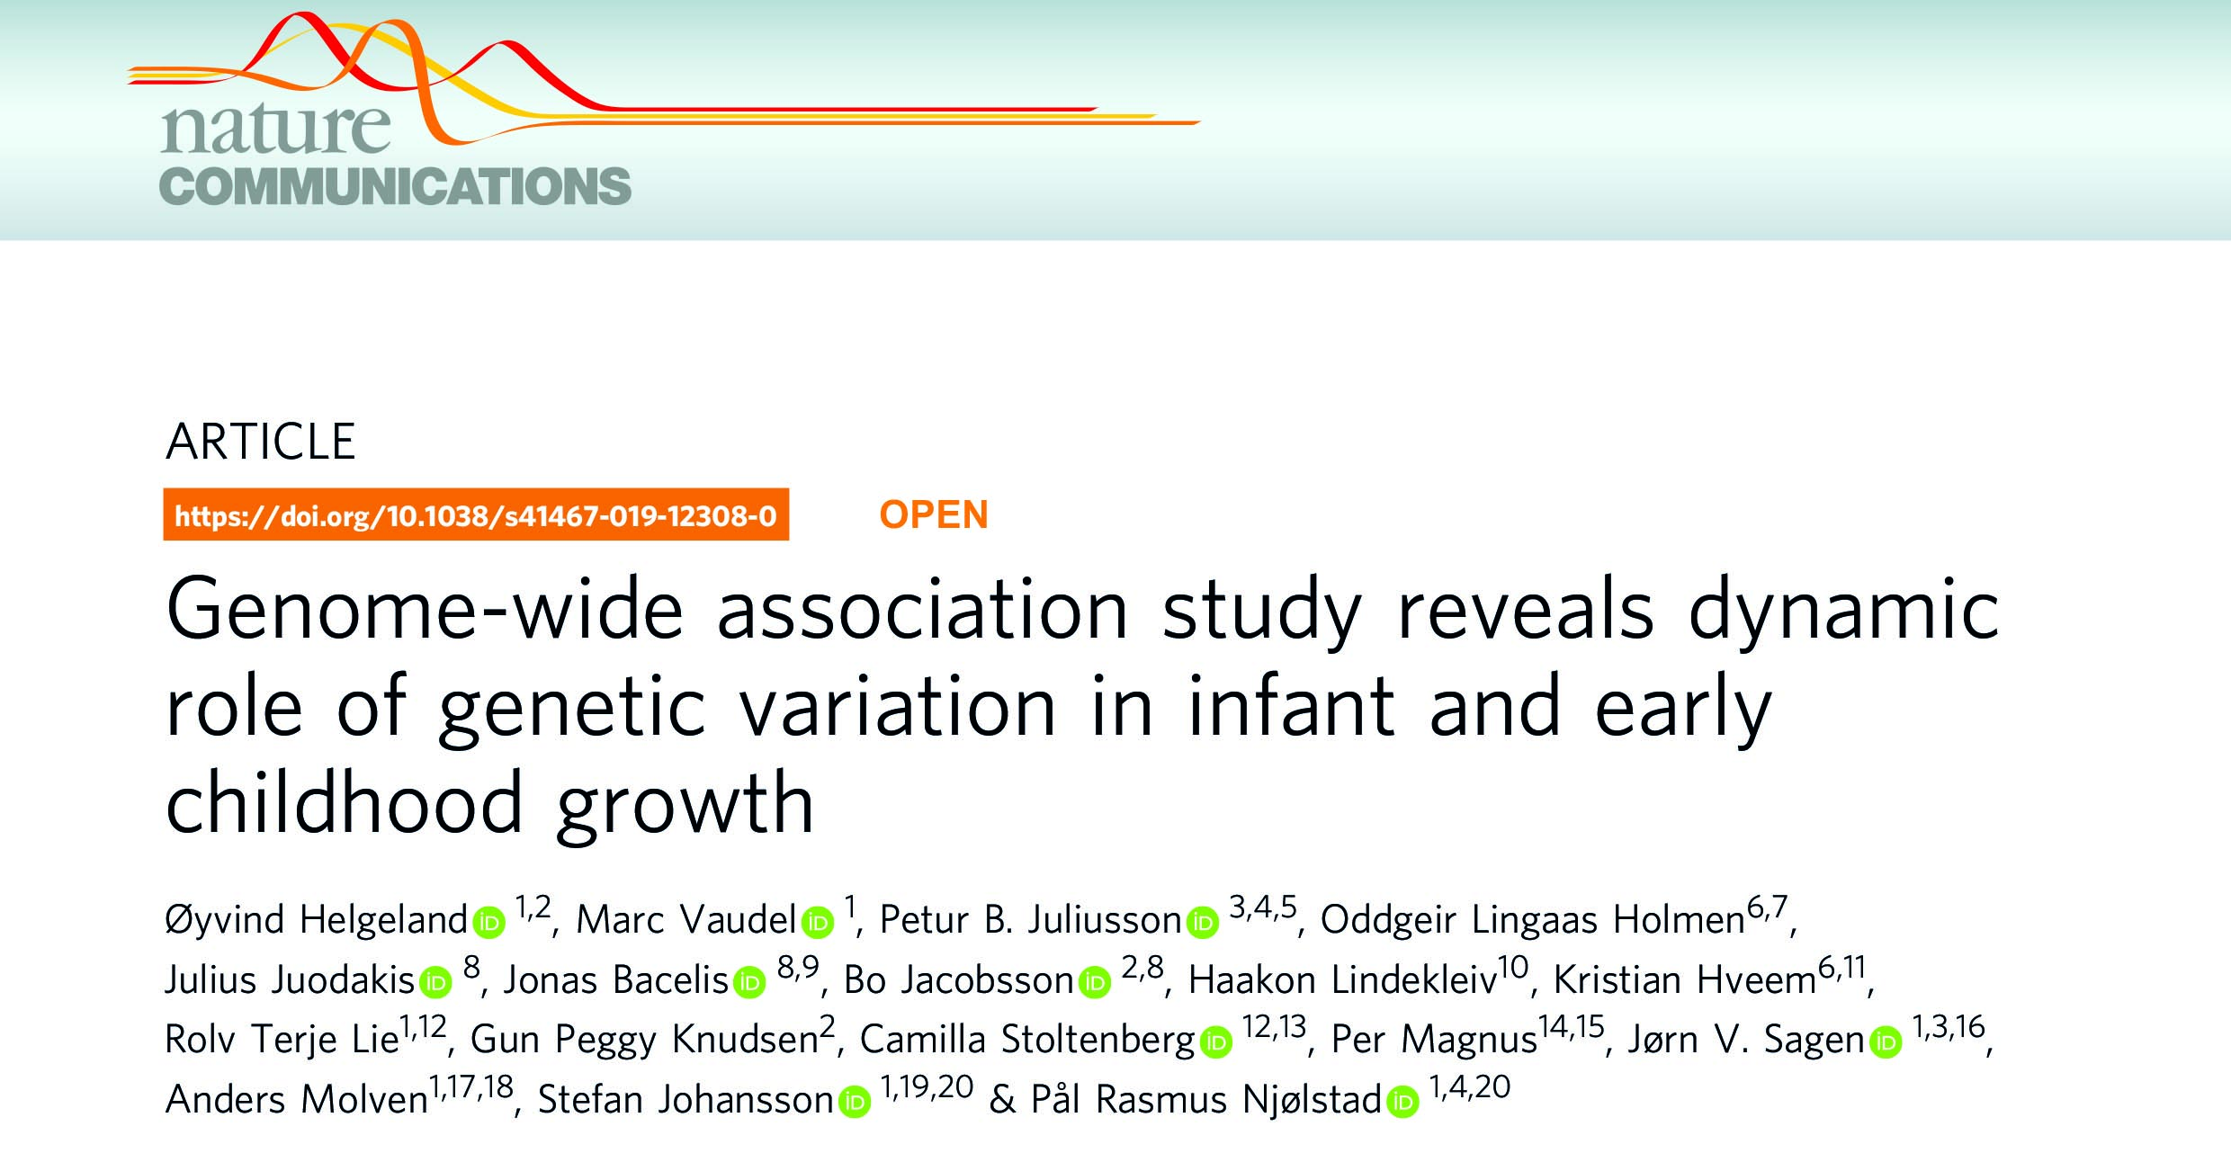
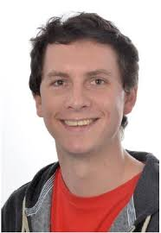
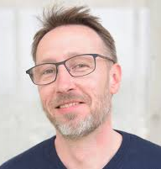
Helgeland et al., Nature Commun, on line

Slide 24
Added value ERC AdG project
Networks
Early Growth Genetics (EGG)
Genetic Investigation of Anthropometric Traits (GIANT)
Harvard, Oxford, Cambridge, MIT
NTNU, NIPH
Data source
UiB-NIPH-UiO NTNU-UiTø agreement (HARVEST)
84,000 GWAS data available now
Working on genotyping all 270,000 samples (Ole Andreassen, Camilla Stoltenberg, others)
Publications
29 published papers directly or indirectly tied to the ERC Project
Co-authored: 3 Nature, 1 Nature Commun, 4 Nature Genet, 1 JAMA, 1 PNAS, 1 PLoS Medicine, ++
UiB in lead: 1 Nature Commun (one line), 1 Nature Genet, 1 Nature Reviews
Now focusing on parent of origin effects and placenta

Slide 25
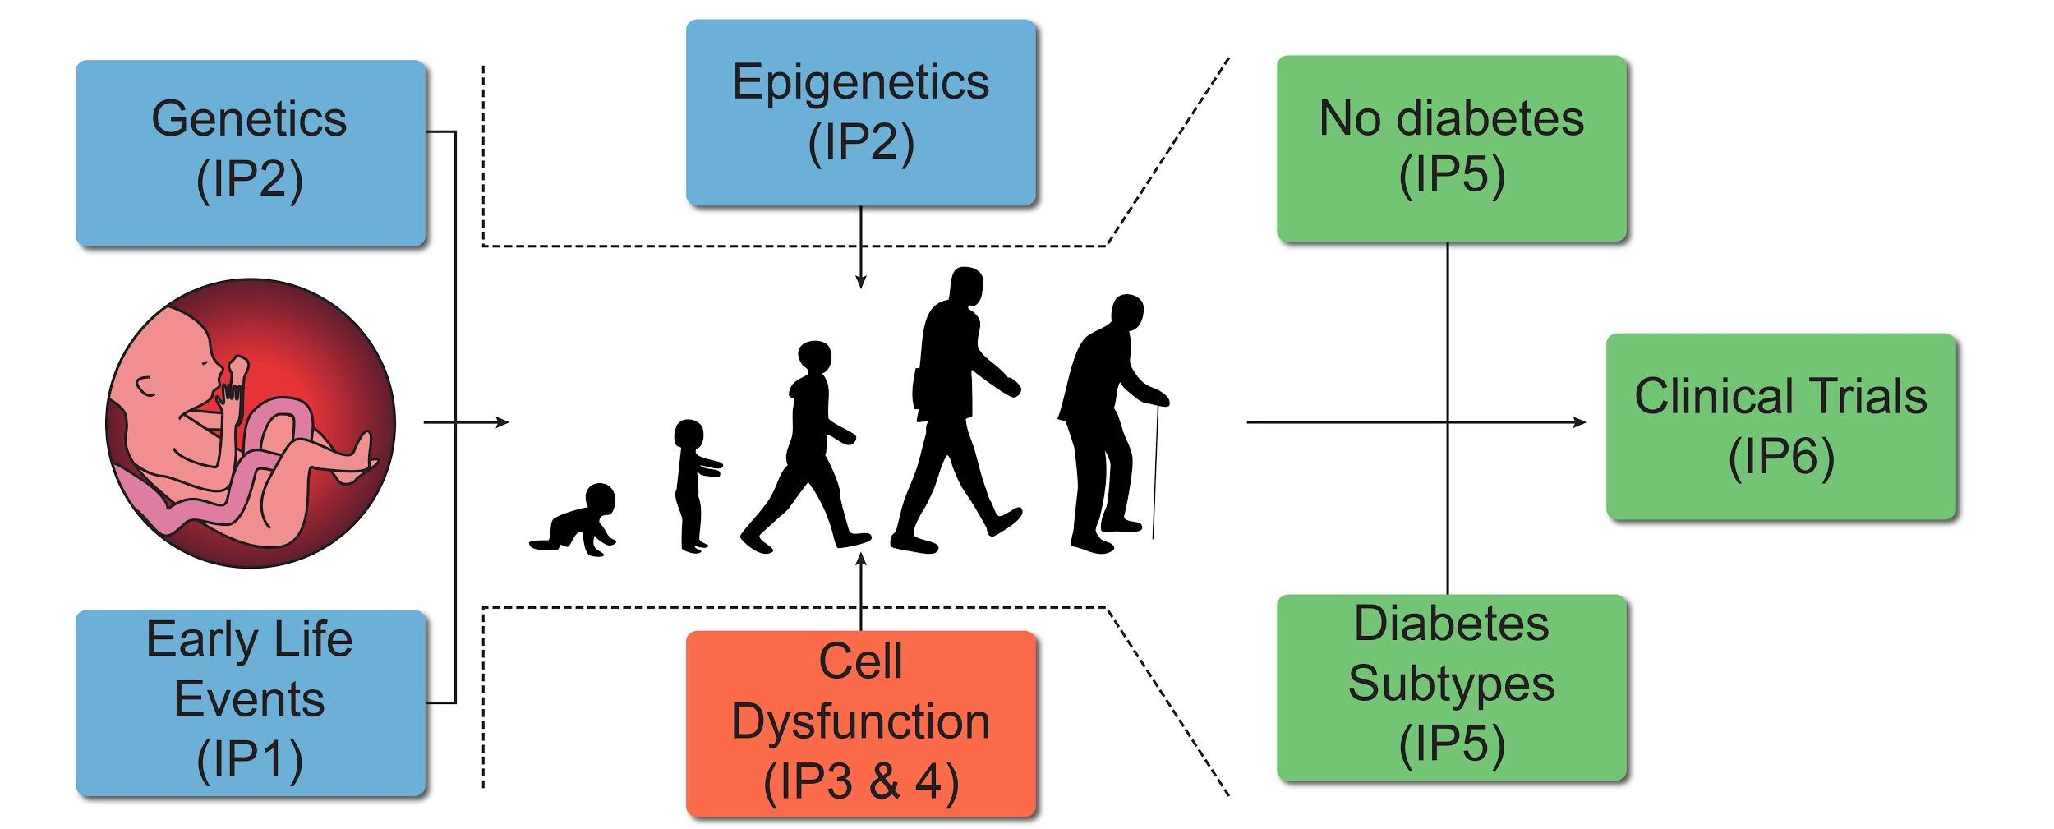
VISION: National diabetes registers w/biobanks 0-100
MoBa Childhood diabetes Adult diabetes??
Monogenic diabetes

Slide 26
Which are the diabetes biobanks in Norway?
Childhood Diabetes Registry
  6 100; data, serum, EDTA
  GWAS of all
  Panel exome of 2 000
  Novo Nordisk Fonden project WGS (18 mNOK)
MODY Registry
  2 200; data, EDTA, serum (some)
  GWAS of all, WES of 350

Slide 27
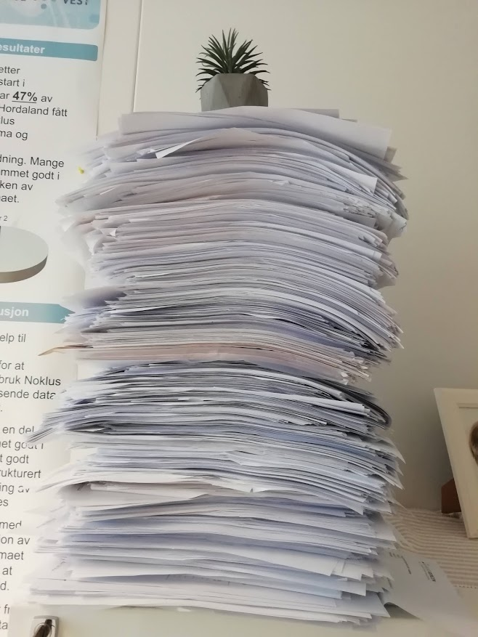
A biobank for the adult diabetes registry
Registry establised 2016
All hospitals in Norway, GPs in progress
58 120 registered (31.12.18)
Biobank established 2019
7 636 consents (20.10.19)
1 232 samples (20.10.19)
Large potential, aim for EDTA and serum of all

Slide 28
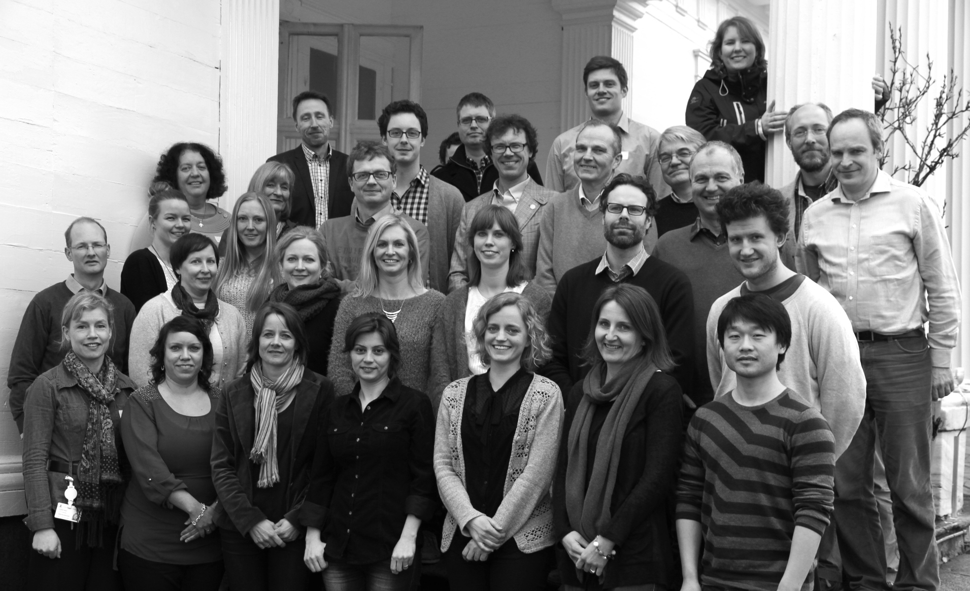


CENTER FOR DIABETES RESEARCH
@JebsenDiabetes
www.mody.no
www.uib.no/diabetes
Thanks for the invitation!
Bergen Group - past & present A Molven, O Søvik, L Bjørkhaug, K Fjeld, S Johansson, B Johansson, H Ræder, J Sagen, T Sandal, J Molnes, M Vesterhus, J Torsvik, JK Hertel, E Tjora, A Ragvin, K Chudasama, M Negahdar, T Hoang, L Najmi, M Dalva, G Helgeland, Ø Helgeland, H Irgens, I Aukrust, M Vaudel, A Kaci, G Mellgren, O Nygård, J Fernø, M Solheim, L Aasmul, M Holmaas, A Hammer
Others from Norway K Dahl-Jørgensen, G Joner, T Skrivarhaug, DE Undlien, PM Thorsby, I Nermoen, I Følling, K Midthjell, K Hveem, O Holmen, C Platou, T Claudi, D Aarskog, I Haldorsen, C Stoltenberg, P Magnus, GP Knutsen, E Husebye
Abroad GI Bell (Chicago), (Joslin, Boston), N Beer, AT Hattersley, AL Gloyn, S Ellard (UK), D Lombardo, M Polak (France), FM Matschinsky, CA Stanley (Philadelphia), N Shehadeh (Israel), A Cuesta-Muñoz (Spain), T Hansen, O Pedersen, H Mortensen (Denmark), T Tuomi (Finland), L Groop, M Orho-Melander, V Lyssenko (Sweden), R Kahn, R Kulkarni, J Winnay, D Altshuler, J Flannick, A Manning, T Rolph, J Hirschhorn, CE & JG Seidman, S Gabriel, JC Florez, M DePristo (Boston), U þorsteinsdóttir, K Stefánsson (Iceland), R Koenig (Germany). UNIV OF CHICAGO; JOSLIN DIABETES CENTER AND BROAD INSTITUTE

